Slide 1
Task 2: Predicting customer buying behavior
Explore and prepare the dataset Train a machine learning model Evaluate model and present findings

Slide 2
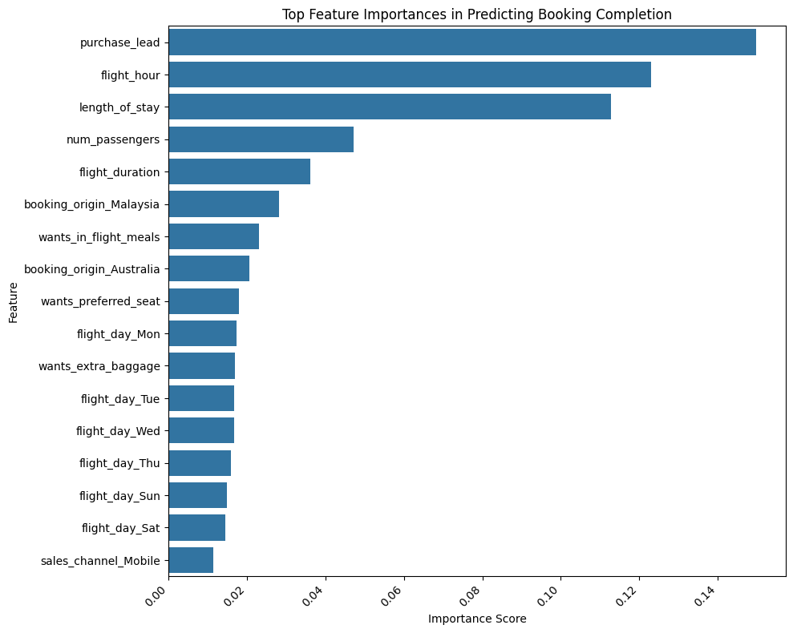
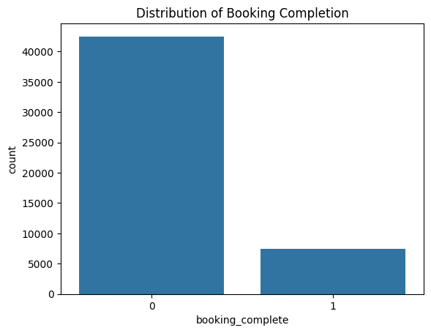
Model Evaluation
Confusion Matrix: [[8362 158] [1283 197]] Accuracy Score: 0.8559 Cross-validation scores: [0.8497 0.7815 0.7255 0.5396 0.7818] Mean cross-validation score: 0.73562

